Slide 1
Inhaled antibiotics in CF
Bruce Montgomery MD
December 2020
Shared for public use – please acknowledge the source.

Slide 2
Cystic Fibrosis
30,000 patients with CF in the USA
Autosomal recessive disease with inactive Cystic Fibrosis Transmembrane Conductance Regulator
Disrupts salt and water transport in organs throughout the body causing chronic lung infection/inflammation, and severe digestive and nutritional failure

Slide 3
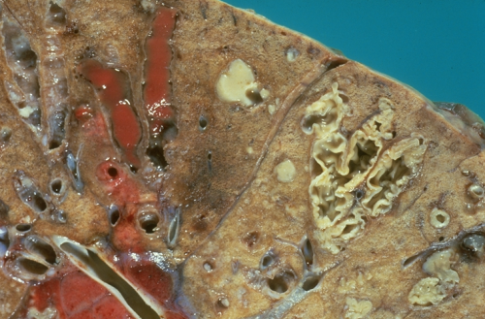
The Lung in Cystic Fibrosis

Slide 4
Age at Death for CF Patients
25
100
20
80
15
* Median = 26.3 yrs
60
Number of Deaths
Cumulative Percent
10
40
5
20
0
5
10
15
20
25
30
35
40
45
50
55
60+
Age at Death (n = 420)
CF Foundation, Patient Registry, Annual Data Report to the Center Directors, 2008.

Slide 5
Relationship Between FEV₁ and Mortality
Adapted from: Kerem et al., N Engl J Med; 326(18):1187-91, 1992.

Slide 6
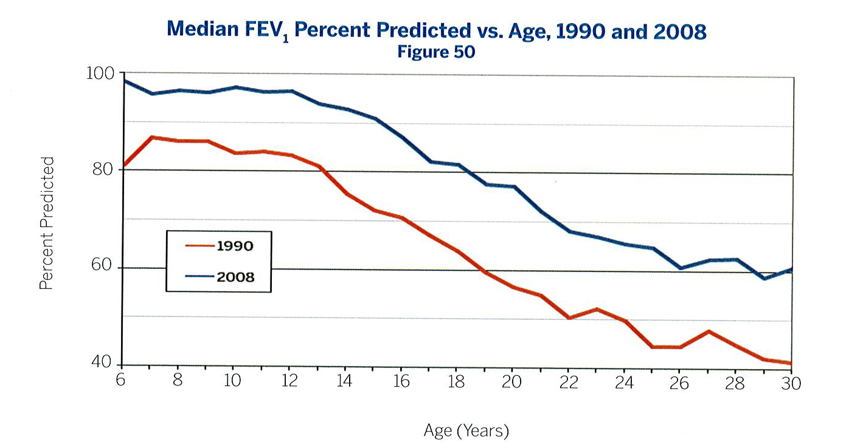
Improved Maintenance of Lung Function
100
80
Median
FEV₁Percent Predicted
60
1990
2008
40
6 8 10 12 14 16 18 20 22 24 26 28 30
Age (years)
CF Foundation, Patient Registry, Annual Data Report to the Center Directors, 2008.
Notes:
6
6

Slide 7
Age Specific Prevalence of Respiratory Infections in CF Patients, 2008
100 –
80 –
60 –
40 –
20 –
0 –
P. aeruginosa
Percent of Patients
S. aureus
MRSA
S. maltophilia
B. cepacia complex
0-1 2-5 6-10 11-17 18-24 25-34 35-44 45+
Age (years)
Adapted from CF Foundation, Patient Registry, Annual Data Report to the Center Directors, 2008.

Slide 8
Key Drivers of Clinical Care
Preservation of lung function
Maintenance of growth and weight
Management of symptoms
  Cough
  Sputum production
  Chest tightness or pain
  Exercise limitations or exertional dyspnea

Slide 9
Clinical Care of CF Lung Disease
Chest physiotherapy 1-3 hours per day
Mucolytics such as DNase or hypertonic saline
Anti-inflammatories such as azithromycin or high-dose ibuprofen
Chronic, suppressive antibiotic therapy
  In US, alternating TOBI and Cayston
  ROW, TOBI and colistin used chronically
CFTR correctors now SOC
  However, do not eliminate infection, just increases life expectancy
  Increases market size for antibiotics

Slide 10
Treatment of Chronic Airway Infection
Goal is suppression, not cure
Recommendations from 2007 treatment guidelines†
  TOBI: well studied, “strongly recommend”
  (28 days on/28 days off therapy)
  Colistin: “evidence is insufficient to recommend”
Oral therapies against PA
  Quinolones: resistance is common
† Flume et al., Am J Respir Crit Care Med, 176, 957-969, 2007.

Slide 11
Unmet needs in CF antibiotic
Colistin does not work
  Not approved in US
  Failed every comparative clinical trial
  Religious cult in the EU, used because of low price
    May want to not spend the time for EMA approval due to price concerns
TOBI is getting long on tooth
  Resistance is developing after 22 years of use
    Breakpoint for aerosol >64ug/ml
    Paucity of studies looking at resistance prevalence
  Azithromycin antagonizes TOBI
    Wide spread use as it increases airway surface liquid
  Does not work as well in adults as adolescents

Slide 12
Steps to Develop a new inhaled antibiotic
Microbiology
Mucin binding
Estimating the dose
Developing a Formulation
Picking a nebulizer
Toxicology studies
Historical review of prior approvals
Putative Clinical Plan

Slide 13
Microbiology
Best to have recent isolates and know history of antibiotic exposure to TOBI, Cayston, and Colistin that should be controls
MIC’s to common CF pathogens
  Pseudomonas
  S. Maltophilia
  B. Cepacia
  S. Aureus
Other organisms of interest
  M avium comples

Slide 14
Mucin binding
High in tobramycin >90%
High in Colistin > 99%
None in Cayston
Effects the amount of drug needed for efficacy
Must know!

Slide 15
Can you estimate the dose?
Yes, the likely half life of an aerosol drug is 90 to 120 minutes in the airway
If you know MOA, peak vs time >MIC vs AUC/MIC and you know MIC, one can model the airway drug concentration needed
To estimate amount need in mg delivered divide estimated peak level needed in ug/gm sputum by 30 and that will give an estimate of mg delivered

Slide 16
What does one need for a formulation
Aqeuous Formulation
  pH 5-7.5
  Osmolality between 0.5 and 2 Normal saline
    150-600 milliosm/kg
  >40 meq/liter of permeant anion (Chloride)
Problematic to deliver enough if not soluble
Ideal is in blow fill seal with two year RT stability
  Tobi refrigerated shipment, 30 day RT
  Cayston a two part formulation

Slide 17
Nebulizer selection
If the dose is > 5mg delivered to lung, DPI’s will not work as they induce cough
Types of nebulizers
  Standard jets, cheap, disposable but only 4-6% delivery efficient
  Breath enhanced nebulizers, resusable, $15, 13% effiecent
  Vibrating plate, expensive, fast, 13-40% efficient, can tune particle size
Expensive drugs should use vibrating plate
  Prevents dose splitting if breath enhanced is the approved nebulizer
  If API is expensive, may actually lead to lower COGs
  However, some require royalty payments for use

Slide 18
Nebulizer issues
Need to characterize the delivery and particle size for the IND
All CF aerosol antibiotics are a drug device combination
User studies needed for NDA

Slide 19
Toxicology
For SAD
  Two species, dog and rat, MTD, seven day
  Single dose Renal, CV and Resp Pharmacology
For Phase 2
  Two species, dog and rat, 28 day
For Phase 3
  Two species, dog and rat, 6 month
For NDA
  Carcinogencity study (may be post approval)

Slide 20
Non GLP Tox studies to consider
Guinea pig allergic response
  Guinea pigs have reactive airways
  50% of CF patients have reactive airways
  Cephalsporin aerosols have about 1/500 risk of severe bronchospasm
  Reason why aztreonam was chosen
Sheep BAL model
  May help determine airway halflife

Slide 21
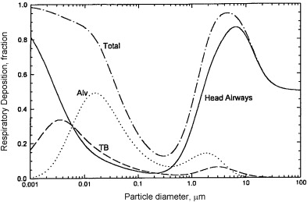
Mode of delivery is key
Particle size determines deposition
21
International Journal of Pharmaceutics 2011 406 (1-2): 1-10

Slide 22
TOBI Study Design
TOBI 300 mg
2 x daily for 4 weeks
then
520 CF Patients Randomized
No Drug for 4 weeks
x 3 Cycles
(N = 258)
Placebo for
4 weeks
then
No Drug for 4 weeks
x 3 Cycles
(N = 262)
Ramsey B, et al. N Engl J Med 1999;340:23-30.
Notes:
22
22

Slide 23
Mean Change in the Forced Expiratory Volume in One Second (FEV₁) in Patients
TOBI*
Placebo
On-treatment
*p <0.001 Active vs. Placebo
Ramsey B, et al. N Engl J Med 1999;340:23-30.
Notes:
23
23
Figure 1.
Mean Change in the Forced Expiratory Volume in One Second (FEV1) in Patients Receiving Inhaled Tobramycin or
Placebo. The mean change from week 0 in FEV1
(expressed as the percentage
of the value predicted on the basis of age, height, and
sex) is shown for each study visit. The shading denotes the periods
when the subjects received tobramycin or placebo. The
I
bars represent 95 percent confidence intervals. FEV
1
values
were available for 257 patients in the tobramycin group and
262 in the placebo group at week 0 and for 232 patients in the
tobramycin group and 231 in the placebo group at week 20.

Slide 24
Mean Change in PA Density in Sputum
Placebo
TOBI*
On-treatment
*p <0.001 Active vs. placebo
Ramsey B, et al. N Engl J Med 1999;340:23-30.
Notes:
24
24

Slide 25
Mean Change in PA Density in Sputum
Placebo
TOBI*
On-treatment
Ramsey B, et al. N Engl J Med 1999;340:23-30.
Notes:
25
25
Figure 2. Mean Change in the Density of P. aeruginosa in Samples
of Expectorated Sputum.
The upper panel shows the mean change from week 0 in the
density of P. aeruginosa in samples of expectorated sputum at
each visit for the 249 patients in the tobramycin group and the
241 in the placebo group. The lower panel shows the mean
change from week 0 at each visit for the subgroup of patients
in the tobramycin group whose most prevalent isolates had a
minimal inhibitory concentration (MIC) of tobramycin of less
than 8 µg per milliliter at week 0. The diamonds represent the
173 patients whose isolates continued to have an MIC of tobramycin
of less than 8 µg per milliliter at week 20, and the triangles
represent the 29 patients whose isolates had an MIC of tobramycin
of 8 µg per milliliter or more at week 20. The I bars
in both panels represent 95 percent confidence intervals.

Slide 26
% Change In FEV₁ From Week 0 To Week 20
According Age
Age (N) | % Change in FEV₁ |  | Treatment Effect† | p-value
 | TOBI | Placebo
6–12 yr (113) | 14.11 | 5.52 | 8.59 | 0.08
13–17 yr (120) | 15.88 | -7.15 | 23.03 | <0.001
≥ 18 yr (229) | 5.52 | -2.64 | 8.16 | <0.001
†The treatment effect was calculated as the difference between the mean changes in the TOBI and placebo groups.
Ramsey B, et al. N Engl J Med 1999;340:23-30.
Notes:
26
26

Slide 27
Hospitalizations
TOBI® Registration Studies
 | Protocol 002 |  | Protocol 003 |  | Pooled 002/003
 | TOBI | Placebo | TOBI | Placebo | TOBI | Placebo
N | 109 | 114 | 149 | 148 | 258 | 262
% Hospitalized | 28% | 45% | 43% | 45% | 37% | 45%
Relative Risk of Hospitalization | .557 |  | .891 |  | .744
95% Confidence Limits | .356 - .871 |  | .631 - 1.258 |  | .567 - .975
Mean Days in Hospital | 4.6 | 9.1 | 5.5 | 7.4 | 5.1 | 8.1
p-value for Days in Hospital | .008 |  | .57 |  | .03
FDA, Pathogenesis Corp. Summary Basis of Approval, Tobramycin Solution for Inhalation, NDA 50-753, Medical Officer Review. 1997.
Notes:
N values from pg. 29
% Hospitalized from pg. 34, 120

Slide 28
ADRs in the TOBI Label
Voice alteration
Tinnitus
Increased serum creatinine

Slide 29
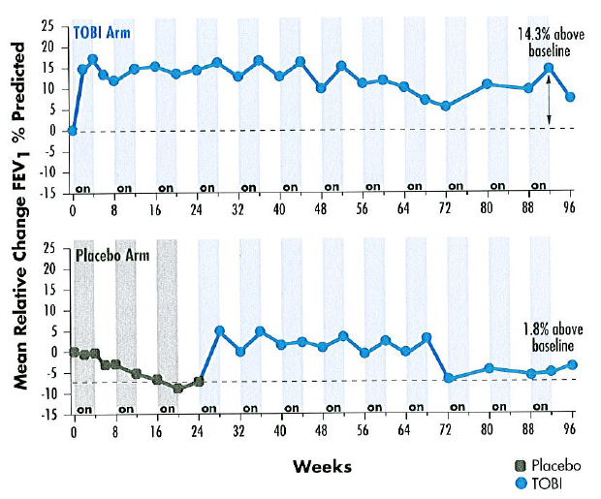
TOBI Registration Studies:
Mean Relative Change in FEV₁ % Predicted
Adolescents
25 -
20 -
15 -
10 -
5 -
0 -
-5 -
-10 -
-15 -
on
on
on
on
on
on
on
on
on
on
on
on
0 8 16 24 32 40 48 56 64 72 80 88 96
Mean Relative Change FEV₁ % Predicted
Adults
25 -
20 -
15 -
10 -
5 -
0 -
-5 -
-10 -
-15 -
on
on
on
on
on
on
on
on
on
on
on
on
0 8 16 24 32 40 48 56 64 72 80 88 96
Weeks
TOBI Technical Monograph 2000
Notes:
29

Slide 30
Barriers to Use of Maintenance Therapies
Only 67% of CF patients with PA receive TOBI one or more times over a year in spite of no other FDA-approved maintenance options†
Barriers to use
  Intolerance (bronchospasm/taste)
  Adverse events
  Lack of effect
  Burden of treatment
  Antimicrobial resistance
† CF Foundation, Patient Registry, Annual Data Report to the Center Directors, 2008.

Slide 31
Increased Prevalence of Resistant PA
% of resistant Isolates
Clavulanate
Adapted from Burns, JL et al. NACFC 2008. Poster 373
MDR-PA: resistance to all drugs in 2 of 3 classes tested

Slide 32
Need for Cayston in 2001
Significant morbidity and mortality with PA infection
> 70% of adult CF patients have chronic PA infection
Chronic suppressive therapy is current standard-of-care
Less than 2/3 of eligible patients can use TOBI
An alternative therapy is urgently needed to treat chronic PA infection in CF

Slide 33
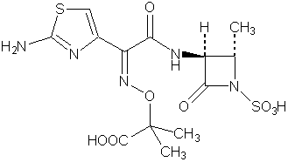
Aztreonam
Monobactam active against PA
Bactericidal activity
  Time-dependent killing
Low cross-resistance to β-lactams
Azactam® is a parenteral formulation (IV/IM) with arginine and was approved in 1986
AZLI is specifically formulated for
  High lung concentrations with low systemic exposure
  Airway tolerability by use of lysine
Azactam® is a registered trademark of Elan Pharmaceuticals, Inc.
Notes:
Aerosol therapy is a better way to treat PA than parenteral therapy.
Gilead was looking to develop an antibiotic that would improve upon the only currently approved option (TOBI). Improvements would include
Better airway tolerability and no cumulative dose-limiting toxicity
Better response in adults
No sputum binding
Faster delivery
AZLI was chosen/developed with the following characteristics:
Aztreonam represented an alternative class of antibiotic, and was well understood and safe from 20 years of use as a parenteral product
Lysine salt was chosen for airway tolerability
The aerosol administration allows for low systemic exposure
Aztreonam doesn’t bind to sputum in the lung, so all of the antibiotic that is deposited in the lung is active
33

Slide 34
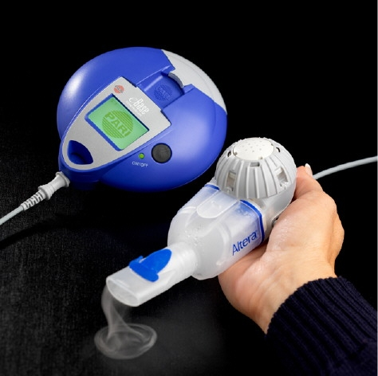
AZLI is Delivered with the PARI Altera® Nebulizer
Small, portable, battery operated
Perforated stainless steel membrane aerosol generator
(eFlow® technology)
1 mL (75 mg) dose delivered in 2-3 minutes
Delivers AZLI to the central and peripheral airways
Altera® and eFlow® is a registered trademark of PARI Pharma GmbH
Notes:
Move quickly through this slide.
The 2-3 minute delivery time with the Altera (new technology) lessens the treatment burden to the patient
34

Slide 35
Double-blind Superiority Studies with Long-term Open-label Extension
Study 005
TOBI
AZLI/Placebo (BID or TID)
Follow-up
1º Endpoint: Time to need for inhaled or IV antibiotics
28 Days
28 Days
56 Days
28 Days
28 Days
Study 006
AZLI
(TID or BID)
off
AZLI
(TID or BID)
28 Days
Up to 9 cycles of therapy
Study 007
AZLI/Placebo (TID)
Follow
-up
1º Endpoint: CFQ-R RSS
28 Days
14 Days
Notes:
35
The Phase 3 program was the result of expedited drug development in an orphan indication with an important medical need.
Study 005 was initiated first.
When designing Study 005, Gilead knew that 75 mg BID was well-tolerated, but wanted to evaluate the tolerability of a TID regimen, given the rapid airway clearance and the mechanism of action of time above the MIC.
The pre-specified analyses called for pooling the treatment and placebo arms, given the sample size concerns in this orphan indication.
When designing Study 007, Gilead used blinded data from Study 005 to determine that the TID regimen was well-tolerated and used the CFQ-R data from the TOBI run-in period to calculate the MCID. Based on the MCID, the sample size of Study 007 was increased.

Slide 36
Study 007: Design and 1° Endpoint (CFQ-R RSS)
Treatment design following 28-day off-drug period
CFQ-R encompasses 12 domains
  Each scored 0 to 100 with 100 being the best
Respiratory Symptoms Scale (RSS) is one of the 12 domains and includes
  Congestion, cough during the day, mucus production, wheezing, trouble breathing, nocturnal wakening from cough
Validation studies in adult and pediatric patients
  National Validation Study†
  National Airway Clearance Study‡
† Modi and Quittner, J Pediatr Psychol. 28(8): 535-45, 2003.
‡ Quittner et al. [abstract 364]. Pediatr Pulmonol. 38(S27): 314-5, 2004.
Notes:
36
CFQ-R
Another key secondary endpoint is a patient-reported outcome, the revised cystic fibrosis questionnaire, or CFQ-R. This instrument encompasses both generic and CF-specific domains.
For Study 005, the respiratory domain is a secondary endpoint. For the on-going 007 study, the respiratory domain of the CFQ-R is the primary endpoint.
36

Slide 37
Study 005: Patient Population and Endpoints
Patient Population
  CF and pulmonary PA
  Age ≥ 6 years
  FEV₁ 25 – 75% predicted
  ≥ 3 courses of TOBI in prior 12 months
Patients randomized to 75 mg AZLI or placebo, BID or TID
Primary Endpoint (pooled AZLI versus pooled placebo)
  Time to need for inhaled or IV antipseudomonal antibiotics
Key Secondary Endpoints
  Change in FEV₁
  Change in CFQ-R RSS
  Change in CFUs in sputum
Notes:
37
Not designed as a dose response study.
Originally intended that the AZLI treatment would maintain the TOBI improvements on from the run-in period; however, we were pleasantly surprised to see that AZLI demonstrated significant further improvements on top of the TOBI effect.

Slide 38
Study 005: Baseline Characteristics
(Day -28)
 | Pooled Placebo (N = 76) | Pooled AZLI (N = 135)
Age, yrs, Mean | 27.9 | 25.3
Age <18 | 12 (15.8%) | 34 (25.2%)
FEV₁ % Pred., Mean | 53.9 | 55.8
CFQ-R RSS, Mean | 62.5 | 65.8
TOBI courses, past 12 months, Mean | 5.26 | 5.36
Log₁₀ PA CFU, Sputum, Mean | 6.33 | 5.99
DNase | 89.5% | 83.0%
Azithromycin | 65.8% | 71.9%
Aztreonam MIC₉₀ for PA | 64 | 64
Notes:
38
38

Slide 39
Study 005 Primary Endpoint: Time to Need Pooled AZLI vs. Pooled Placebo
p = 0.007
Day 84 KM
AZLI
(0.33)
Placebo:
71 days (median)
Placebo
(0.56)
AZLI:
92 days (median)
AZLI /Placebo
28 Days
Follow-Up
56 Days

Slide 40
Study 005 Key Secondary Endpoints:
FEV₁, CFQ-R RSS, and CFUs
Day 28 Mean Change | TOBI Run-in (N = 246) | Pooled Placebo (N = 76) | Pooled AZLI (N = 135) | Treatment Effect (∆) | p-value
FEV₁ (L) % | 0.9 | -2.4 | 3.9 | ∆ = 6.3 | p = 0.001
CFQ-R RSS | -1.5 | -0.7 | 4.3 | ∆ = 5.0 | p = 0.02
Sputum Log₁₀ PA CFU | -0.28 | 0.23 | -0.43 | ∆ = -0.66 | p = 0.006
p-values from parametric ANCOVA
Last value carried forward
Notes:
40

Slide 41
Phase 3 Program Overview
Study 005
TOBI
AZLI/Placebo (BID or TID)
Follow-up
1º Endpoint: Time to need for inhaled or IV antibiotics
28 Days
28 Days
56 Days
28 Days
28 Days
Study 006
AZLI
(TID or BID)
off
AZLI
(TID or BID)
Study 007
28 Days
Up to 9 cycles of therapy
AZLI/Placebo (TID)
Follow
-up
1º Endpoint: CFQ-R RSS
28 Days
14 Days
Notes:
41
41
The Phase 3 program was the result of expedited drug development in an orphan indication with an important medical need.
Study 005 was initiated first.
When designing Study 005, Gilead knew that 75 mg BID was well-tolerated, but wanted to evaluate the tolerability of a TID regimen, given the rapid airway clearance and the mechanism of action of time above the MIC.
The pre-specified analyses called for pooling the treatment and placebo arms, given the sample size concerns in this orphan indication.
When designing Study 007, Gilead used blinded data from Study 005 to determine that the TID regimen was well-tolerated and used the CFQ-R data from the TOBI run-in period to calculate the MCID. Based on the MCID, the sample size of Study 007 was increased.

Slide 42
Study 007: Patient Population
Patient Population
  CF and pulmonary PA
  Age ≥ 6 years
  FEV₁ 25 – 75% predicted
  No use of anti-PA antibiotics in the past 28 days
Patients randomized to 75 mg AZLI or placebo TID
Notes:
42
42

Slide 43
Study 007: Endpoints
Primary endpoint
  Change in CFQ-R RSS at Day 28
Key secondary endpoints in order of analysis†
  CFQ-R RSS responder analysis based on MCID of 5 points
  Percent change in FEV₁
  Change in PA CFUs in sputum
  Percent of patients who received IV or inhaled antibiotics
  Percent of patients hospitalized
† Gatekeeper approach was used to preserve alpha.
Notes:
43
43
43

Slide 44
Study 007: Baseline Characteristics (Day 0)
 | Placebo N = 84 | AZLI TID N = 80
Age, yrs, Mean | 31.7 | 27.4
Age < 18 | 16 (19.0%) | 21 (26.3%)
FEV₁, % Pred., Mean | 54.8 | 54.4
CFQ-R RSS, Mean | 60.9 | 60.5
TOBI courses, past 12 months, Mean | 1.7 | 1.8
Log₁₀ PA CFU, Sputum, Mean | 6.27 | 6.57
DNase | 64.3% | 66.3%
Aztreonam MIC₉₀ for PA | 64 | 128
Notes:
44
44

Slide 45
Study 007 Primary Endpoint: Change in CFQ-R RSS
AZLI TID
* Treatment difference = 9.71
p = 0.0005
*
Placebo
AZLI /Placebo
28 Days
Follow-Up
14 Days
Notes:
45
45

Slide 46
Study 007: Percent Change in FEV₁
*Treatment difference = 10.3%
p < 0.0001
*
AZLI TID
Placebo
AZLI /Placebo
28 Days
Follow-Up
14 Days
Notes:
46
46

Slide 47
Study 007: Change in CFU in Sputum
Placebo
*
AZLI TID
* Treatment Difference = -1.453
p < 0.0001
AZLI /Placebo
28 Days
Follow-Up
14 Days
Notes:
47
47
47

Slide 48
Phase 3 Program Overview
Study 005
TOBI
AZLI/Placebo (BID or TID)
Follow-up
1º Endpoint: Time to need for inhaled or IV antibiotics
28 Days
28 Days
56 Days
28 Days
28 Days
Study 006
AZLI
(TID or BID)
off
AZLI
(TID or BID)
Study 007
28 Days
Up to 9 cycles of therapy
AZLI/Placebo (TID)
Follow
-up
1º Endpoint: CFQ-R RSS
28 Days
14 Days
Notes:
48
48
The Phase 3 program was the result of expedited drug development in an orphan indication with an important medical need.
Study 005 was initiated first.
When designing Study 005, Gilead knew that 75 mg BID was well-tolerated, but wanted to evaluate the tolerability of a TID regimen, given the rapid airway clearance and the mechanism of action of time above the MIC.
The pre-specified analyses called for pooling the treatment and placebo arms, given the sample size concerns in this orphan indication.
When designing Study 007, Gilead used blinded data from Study 005 to determine that the TID regimen was well-tolerated and used the CFQ-R data from the TOBI run-in period to calculate the MCID. Based on the MCID, the sample size of Study 007 was increased.

Slide 49
Study 006: Consistency of AZLI TID Effect in FEV₁ and CFQ-R RSS
AZLI On/Off
n, 185 165 132 122
Notes:
49
49
Updated

Slide 50
Susceptibility and Emergence of Pathogens
No sustained decreases in PA susceptibility to 9 other antipseudomonal antibiotics
No increase in incidence of S. maltophilia, A. xylosoxidans, B. cepacia and MRSA
Aspergillus prevalent at baseline
(21% of patients in Study 006 culture-positive)
  ~10% increase in incidence of Aspergillus species
  No documented cases of pulmonary aspergilloma or invasive aspergillosis
Notes:
The microbiology data were supportive of antibiotic effect (CFU decline) and demonstrated no apparent development of resistance or superinfection.
50

Slide 51
Safety Findings: AZLI 75 mg TID
No clinical concerns of airway reactivity
Only statistically significant event was pyrexia
  Lower rates with subsequent re-exposure
AEs mostly respiratory
No significant hematological or chemistry findings in controlled studies
SAE respiratory event rates similar to placebo
Phase 3 exposure (n = 411), Expanded Access Program (n > 500)
  No anaphylaxis or drug related systemic SAEs found
Notes:
There were 9 adverse drug reactions (ADRs) thought to be reasonably associated with the use of AZLI. All of the ADRs were typical for patients with CF lung disease.
The majority of adverse events were respiratory in nature. There were no significant differences in the rates of SAEs between AZLI and placebo.
No new safety concerns arose from Study 006 in which patients were treated with up to 18 months of therapy.
51

Slide 52
Benefit: AZLI Improves Respiratory Symptoms and Lung Function
Benefit demonstrated in Studies 005 and 007
  Study 007: 10% improvement in FEV₁
  Study 005: 6% improvement in FEV₁ post-TOBI course
Benefit in both symptoms and lung function regardless of age, gender, disease severity
Benefit demonstrated in MDR-PA patients
Consistency of effect in Study 006 over 18 months

Slide 53
Putative Clinical Plan
Phase 1
  SAD in NHV, with CF cohort
Phase 2a
  MAD for 2 weeks in CF cohort
    Endpoint sputum PA density change
Phase 2b
  28 day in CF placebo controlled coming off course of Cayston
6 month H2H trials with TOBI, alternating 28 days with Cayston

Slide 54
Conclusions
A program is doable
Need expertise in multiple areas
Godspeed!

