Slide 1
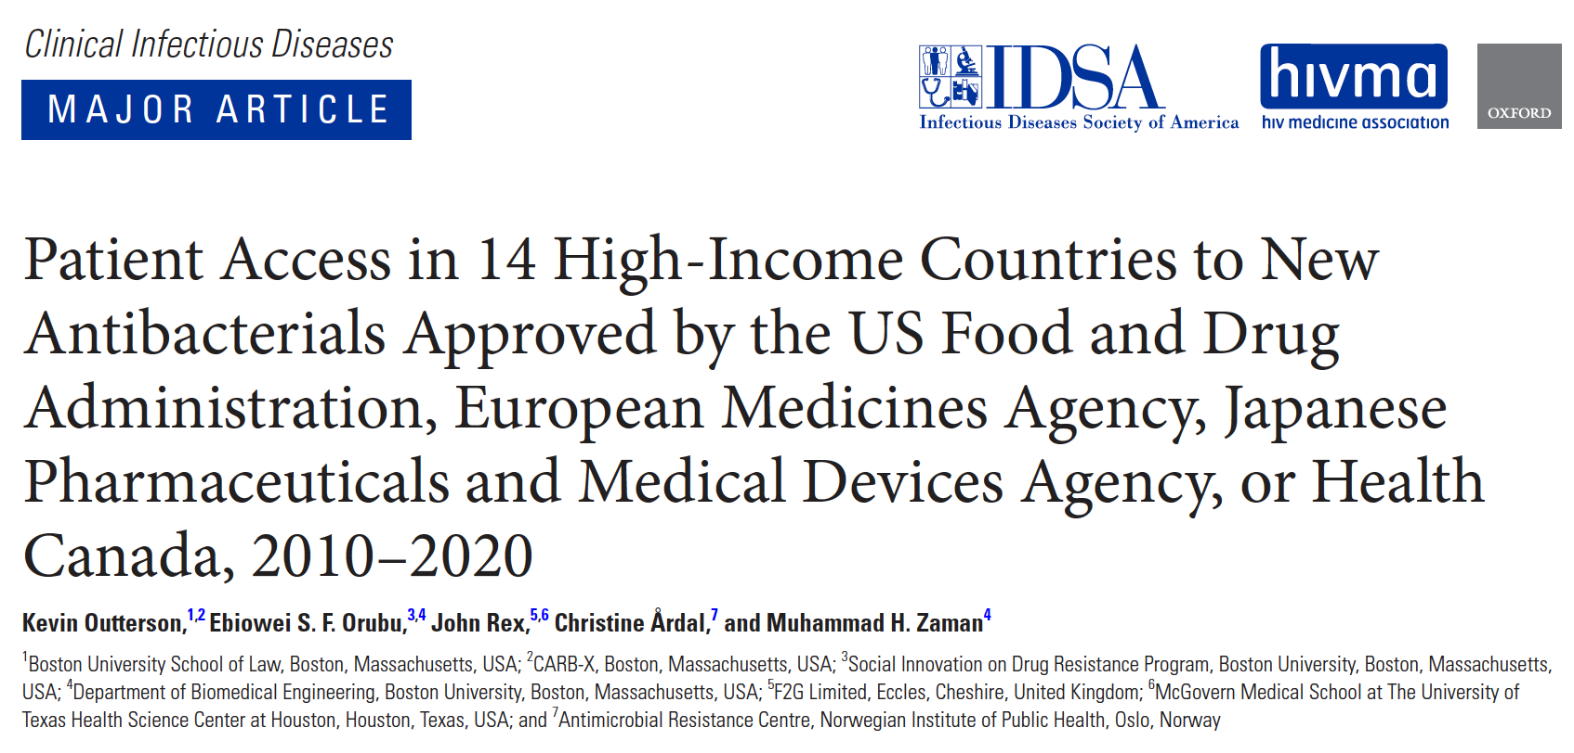

Slide 2
Background
Questions:
Were the IDSA goals achieved?
Are these drugs getting to patients and therefore improving clinical practice?
Is the R&D ecosystem healthier now?
IDSA. CID 2010:50;1081-1083.

Slide 3
Data
All new molecular entity systemic antibacterials first approved for human use by FDA, EMA, JPMD, or Health Canada from 1.1.2010 to 12.31.2019
Regulatory approval and commercial launch (first commercial sale) dates collected in the G7 and a convenience sample of 7 other high-income European countries
Other drug data collected included sales in largest market for last 12 months; whether the drug was on various lists indicative of innovation or clinical need; and sponsor characteristics
Complete Excel database available in the Boston University Institutional Data Repository: https://hdl.handle.net/2144/42657.

Slide 4
Methods
Descriptive statistics
Calculate median launch lags (MLLs) for drugs with >1 launches
Test correlations of MLLs with:
Proxies for possible clinical importance from WHO & Pew
Placement on the WHO Essential Medicines List & AWaRe List
Drug Resistance Index
Sponsor characteristics (large company v. SME)
National total health expenditures (supplement) (World Bank)

Slide 5
Top line results
Results
18 NME antibacterials approved and launched
In only 3 countries (US, UK, Sweden) were a majority of these 18 launched
Regulatory approval by EMA did not lead to timely launch in many EMA countries
MLLs were unrelated to proxies for innovation, drug resistance, or national health expenditures
Placement on WHO Essential Medicines List predicted significantly longer MLLs
Commercial prospects of the sponsors are very poor

Slide 6
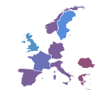
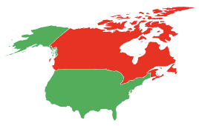
Number of commercial launches
Results
Number of commercial launches
United States - 17
EMA* - 14
UK – 11
Sweden – 10
France – 8
Germany – 7
Italy – 7
Norway – 7
Spain – 7
Greece – 6
Romania – 6
Croatia – 5
Denmark – 5
Japan – 5
Canada - 2
*For EMA, approvals only
Patient Access CID 2021

Slide 7
Results
Limited availability in high-income countries, outside US
Approval and commercial launch in fourteen high-income countries of NME antibacterials first approved by FDA, EMA, PMDA, or Health Canada, 2010-2019
All data as of 12/31/20
Notes: INN = international nonproprietary name; Empty cell = not commercially launched, except in the EMA column where empty cell = not approved by EMA; Number = lag from first approval to commercial launch, in days, except in the EMA column where number = lag from first approval to EMA approval, in days. The US was the country for all first approvals and first commercial launches, with the exception of lascufloxacin, approved and launched only in Japan. Color key: green = lowest lag in days; red = highest lag in days; yellow = 50th percentile lag in days.
Source: Outterson K, Orubu ESF, Rex J, Årdal C, Zaman MH. Clin Infect Dis 2021.
Notes:
The antibiotics approved over the past decade are not selling well, and are not being commercially launched even in high-income countries

Slide 8
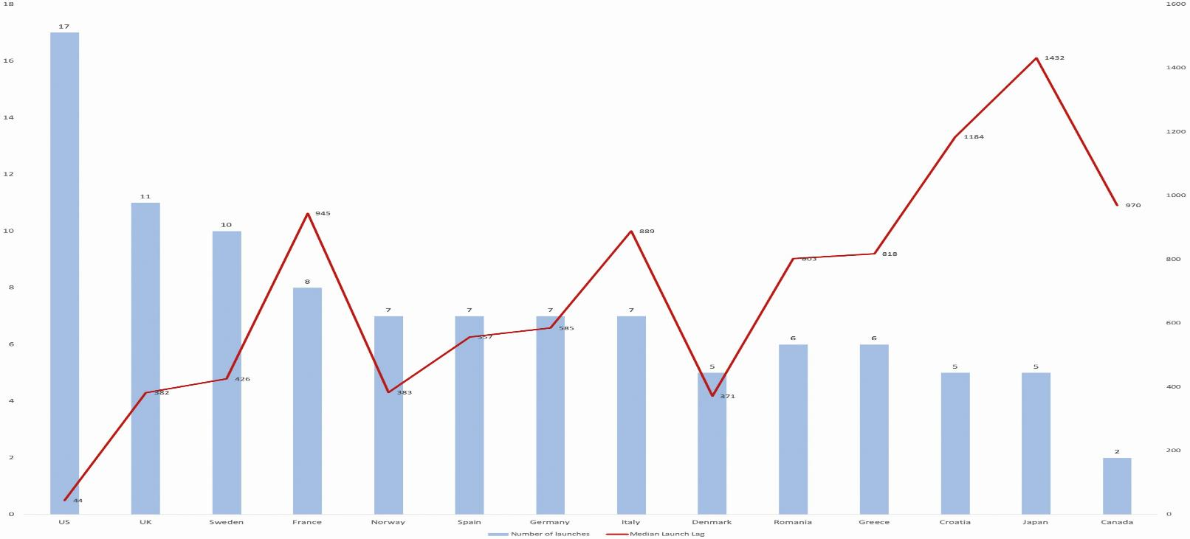
Figure 1. Median launch lag, in days (right axis) and number of launches (left axis) in 14 high-income countries for new molecular entity antibacterials first approved by the FDA, EMA, JPMDA, or Health Canada, 2010–2019.
Results
Abbreviations: EMA, European Medicines Agency; FDA, United States Food and Drug Administration; UK, United Kingdom; JPMDA, Japanese Pharmaceuticals and Medical Devices Agency.
Notes:
Figure 1. Median launch lag, in days (right axis) and number of launches (left axis) in 14 high-income countries for new molecular entity antibacterials first approved by the United States Food and Drug Administration, European Medicines Agency, Japanese Pharmaceuticals and Medical Devices Agency, or Health Canada, 2010–2019. Abbreviations: UK, United Kingdom; US, United States.
Unless provided in the caption above, the following copyright applies to the content of this slide: © The Author(s) 2021. Published by Oxford University Press for the Infectious Diseases Society of America. All rights reserved. For permissions, e-mail: journals.permissions@oup.com.This article is published and distributed under the terms of the Oxford University Press, Standard Journals Publication Model (https://academic.oup.com/journals/pages/open_access/funder_policies/chorus/standard_publication_model)

Slide 9
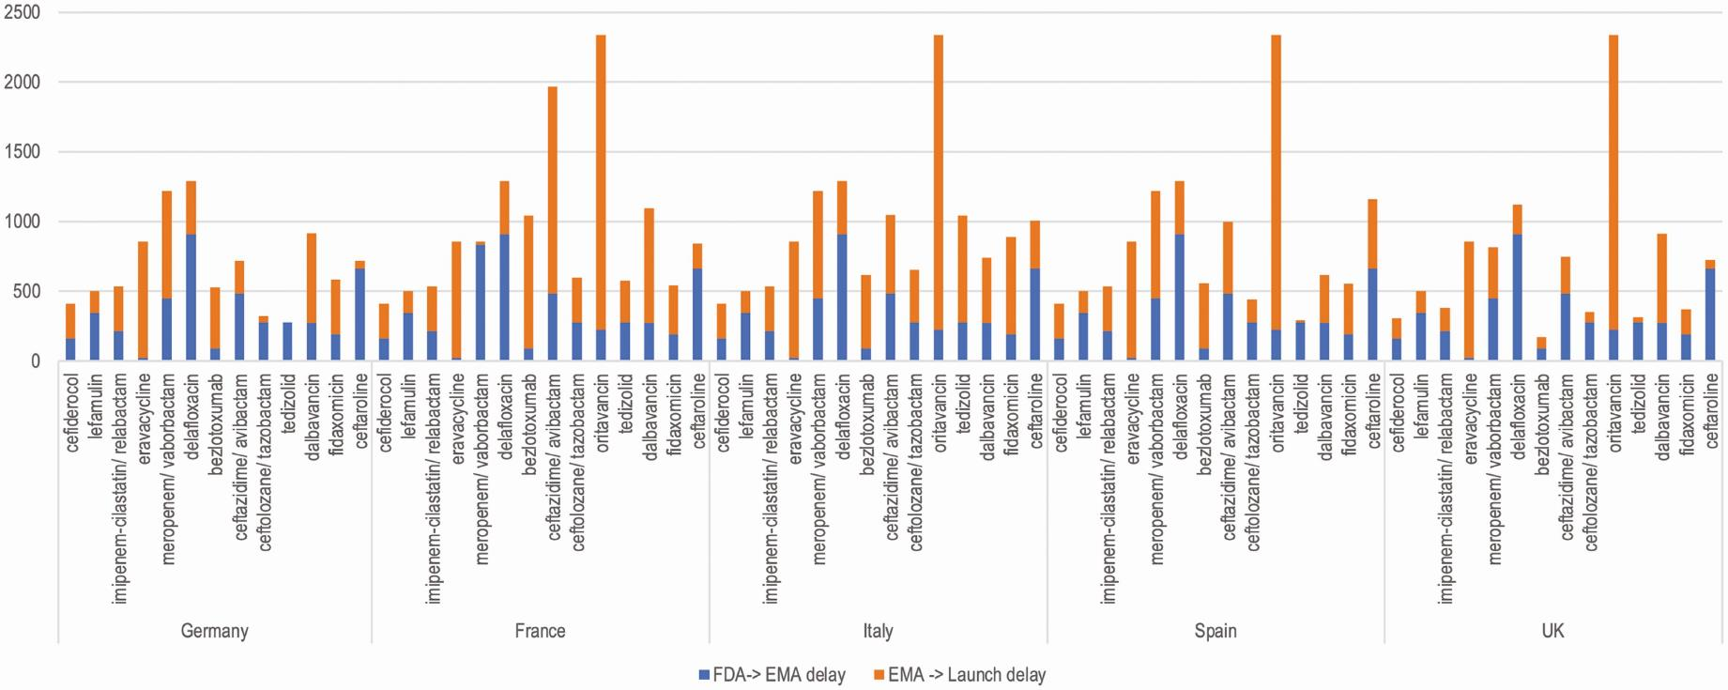
Figure 2. Delay in days before and after EMA approval for 13 recently approved antibacterials with approvals by both the FDA and EMA, in 5 high-income European countries.
Results
Abbreviations: EMA, European Medicines Agency; FDA, United States Food and Drug Administration; UK, United Kingdom.
Notes:
Figure 2. Delay in days before and after European Medicines Agency (EMA) approval for 13 recently approved antibacterials with approvals by both the United States Food and Drug Administration and EMA, in 5 high-income European countries. Abbreviations: EMA, European Medicines Agency; FDA, Food and Drug Administration; UK, United Kingdom.
Unless provided in the caption above, the following copyright applies to the content of this slide: © The Author(s) 2021. Published by Oxford University Press for the Infectious Diseases Society of America. All rights reserved. For permissions, e-mail: journals.permissions@oup.com.This article is published and distributed under the terms of the Oxford University Press, Standard Journals Publication Model (https://academic.oup.com/journals/pages/open_access/funder_policies/chorus/standard_publication_model)

Slide 10
Scatter plot of DRI and MLLs for new molecular entity antibacterials first approved by the FDA, EMA, JPMDA, or Health Canada, 2010–2019, in 14 high-income countries
Results
Median launch lag was not correlated to drug resistance in the country, as proxied by the Drug Resistance Index
From the Supplement. Abbreviations: DRI, Drug Resistance Index; MLL, median launch lag

Slide 11
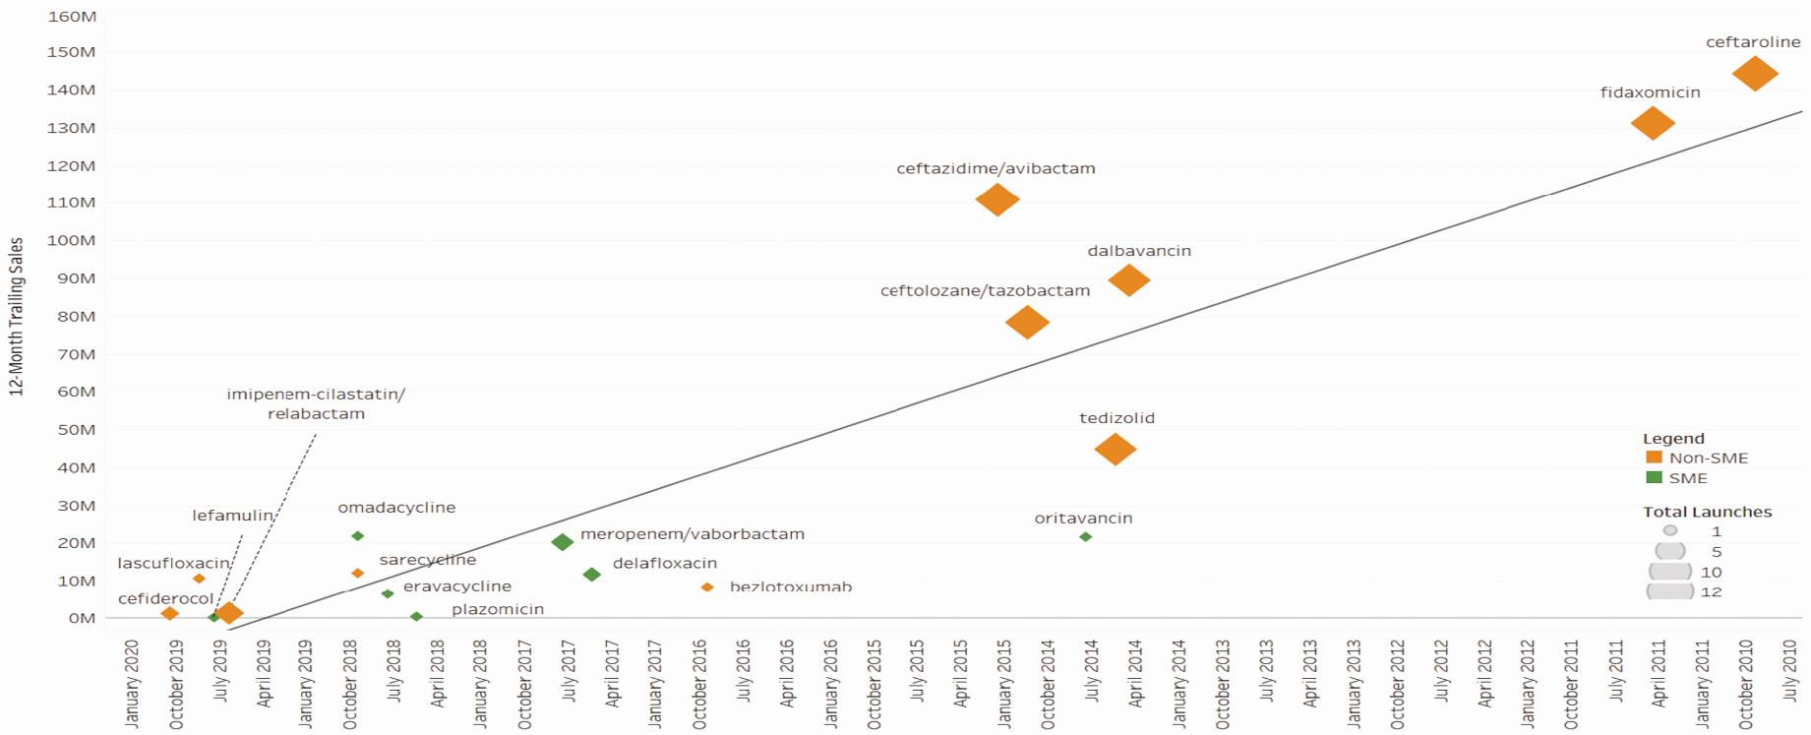
Figure 3. United States trailing 12-month sales for antibacterials approved 2010–2019, by launch date, sponsor size, and number of high-income country commercial launches, with linear trend.
Results
Abbreviation: SME, small or medium enterprise.
Notes:
Figure 3. United States trailing 12-month sales for antibacterials approved 2010–2019, by launch date, sponsor size, and number of high-income country commercial launches, with linear trend. Abbreviation: SME, small or medium enterprise.
Unless provided in the caption above, the following copyright applies to the content of this slide: © The Author(s) 2021. Published by Oxford University Press for the Infectious Diseases Society of America. All rights reserved. For permissions, e-mail: journals.permissions@oup.com.This article is published and distributed under the terms of the Oxford University Press, Standard Journals Publication Model (https://academic.oup.com/journals/pages/open_access/funder_policies/chorus/standard_publication_model)

Slide 12
Conclusion
Were the IDSA goals achieved?
Numerically, yes
Are these drugs getting to patients and therefore improving clinical practice?
No, not in many high-income countries and therefor probably not in poorer settings as well
Is the R&D ecosystem healthier now?
No, the commercial prospects are very poor
IDSA. CID 2010:50;1081-1083.

