Slide 1
Strategies for Early R&D: Plumbing, Phase 3, and Durable Value
John H. Rex, MD
Chief Medical Officer, F2G Ltd Editor-in-Chief, AMR.Solutions Operating Partner, Advent Life Sciences Adjunct Professor of Medicine, McGovern Medical School
22 June 2022
NIAID - Early R&D Strategies for Novel Antibacterial and Antifungal Drugs
Email: john.h.rex@gmail.com
Newsletter: http://amr.solutions
Slides happily shared … just drop me a note
Please note these details!

Slide 2
Executive Summary (& Agenda)
We really need new antibiotics! Glad you are here!
Focus on antibacterials and antifungals: WHO Priority Pathogens
We need you to get busy! AMR is killing us!
I can’t cover everything in 30 minutes!
Further resources: Read, Listen, and Learn!
Attend to the plumbing: Avoid leaks in the pipe(line)
Anticipate Phase 3: Is your product developable?
If you build it, will they come? Embed durable value
Summary

Slide 3
Pathogen (WHO category) | WHO (2017) | Indian* (2021) | CDC (2019) | CDC (2013) | ESKAPE (2008-9)
Acinetobacter baumannii, carbapenem-R | Critical | Critical | Urgent (carbapenem-R) | Serious (MDR) | Yes
Pseudomonas aeruginosa, carbapenem-R | Critical | Critical | Serious (MDR) | Serious (MDR) | Yes
Enterobacteriaceae, carbapenem-R, 3rd-gen ceph-R (ESBL+) | Critical | Critical | Urgent (carbapenem-R) Serious (ESBL+) | Urgent (carbapenem-R) Serious (ESBL+) | Yes
Enterococcus faecium, vancomycin-R | High | High | Serious (VRE) | Serious (VRE) | Yes
Staphylococcus aureus, methicillin-R, vancomycin-I/R | High | High | Serious (MRSA) | Serious (MRSA) Concerning (VRSA) | Yes
Helicobacter pylori, clarithromycin-R | High
Campylobacter spp., fluoroquinolone-R | High |  | Serious (drug-R) | Serious (drug-R)
Salmonellae spp., fluoroquinolone-R | High | High (drug-R) | Serious (drug-R, Typhi & non-typhoidal) | Serious (drug-R)
Neisseria gonorrhoeae, 3rd-gen ceph-R, fluoroquinolone-R | High |  | Urgent (drug-R) | Urgent (drug-R)
Neisseria meningitidis, 3rd-gen ceph-R, fluoroquinolone-R |  | Medium
Streptococcus pneumoniae, penicillin-NS | Medium | Medium | Serious (drug-R) | Serious (drug-R)
Haemophilus influenzae, ampicillin-R | Medium | Medium
Shigella spp., fluoroquinolone-R | Medium | Medium | Serious (drug-R) | Serious
Staphylococcus, coagulase-neg, Van/Lzd-R |  | Medium
Clostridium difficile |  |  | Urgent | Urgent
Candida spp. fluconazole-R |  |  | Urgent (C. auris) Serious (Drug-resistant) | Serious (Flu-R)
M. tuberculosis |  |  | Serious (drug-R) | Serious (drug-R)
Group A Streptococcus |  |  | Concerning (erythro-R) | Concerning (erythro-R)
Group B Streptococcus |  |  | Concerning (clinda-R) | Concerning (clinda-R)
Aspergillus fumigatus |  |  | Watch (azole-R)
Mycoplasma genitalium |  |  | Watch (drug-R)
Bordetella pertussis |  |  | Watch (drug-R)
*Note that the Indian PPL sometimes differs slightly from WHO in terms of precise patterns of qualifying R.
Priority Pathogen Lists compared
https://amr.solutions/pathogens-and-pipelines/
Last updated 18 Mar 2021

Slide 4
Pathogen (WHO category) | WHO (2017) | Indian* (2021) | CDC (2019) | CDC (2013) | ESKAPE (2008-9)
Acinetobacter baumannii, carbapenem-R | Critical | Critical | Urgent (carbapenem-R) | Serious (MDR) | Yes
Pseudomonas aeruginosa, carbapenem-R | Critical | Critical | Serious (MDR) | Serious (MDR) | Yes
Enterobacteriaceae, carbapenem-R, 3rd-gen ceph-R (ESBL+) | Critical | Critical | Urgent (carbapenem-R) Serious (ESBL+) | Urgent (carbapenem-R) Serious (ESBL+) | Yes
Enterococcus faecium, vancomycin-R | High | High | Serious (VRE) | Serious (VRE) | Yes
Staphylococcus aureus, methicillin-R, vancomycin-I/R | High | High | Serious (MRSA) | Serious (MRSA) Concerning (VRSA) | Yes
Helicobacter pylori, clarithromycin-R | High
Campylobacter spp., fluoroquinolone-R | High |  | Serious (drug-R) | Serious (drug-R)
Salmonellae spp., fluoroquinolone-R | High | High (drug-R) | Serious (drug-R, Typhi & non-typhoidal) | Serious (drug-R)
Neisseria gonorrhoeae, 3rd-gen ceph-R, fluoroquinolone-R | High |  | Urgent (drug-R) | Urgent (drug-R)
Neisseria meningitidis, 3rd-gen ceph-R, fluoroquinolone-R |  | Medium
Streptococcus pneumoniae, penicillin-NS | Medium | Medium | Serious (drug-R) | Serious (drug-R)
Haemophilus influenzae, ampicillin-R | Medium | Medium
Shigella spp., fluoroquinolone-R | Medium | Medium | Serious (drug-R) | Serious
Staphylococcus, coagulase-neg, Van/Lzd-R |  | Medium
Clostridium difficile |  |  | Urgent | Urgent
Candida spp. fluconazole-R |  |  | Urgent (C. auris) Serious (Drug-resistant) | Serious (Flu-R)
M. tuberculosis |  |  | Serious (drug-R) | Serious (drug-R)
Group A Streptococcus |  |  | Concerning (erythro-R) | Concerning (erythro-R)
Group B Streptococcus |  |  | Concerning (clinda-R) | Concerning (clinda-R)
Aspergillus fumigatus |  |  | Watch (azole-R)
Mycoplasma genitalium |  |  | Watch (drug-R)
Bordetella pertussis |  |  | Watch (drug-R)
#AMRSOS! GRAM Report: “At Least 1.27m Deaths/Year Directly Attributable To AMR”
Murray et al. Global burden of bacterial antimicrobial resistance in 2019: a systematic analysis. The Lancet: https://doi.org/10.1016/S0140-6736(21)02724-0
*Note that the Indian PPL sometimes differs slightly from WHO in terms of precise patterns of qualifying R.
Priority Pathogen Lists compared
https://amr.solutions/pathogens-and-pipelines/
Last updated 18 Mar 2021

Slide 5
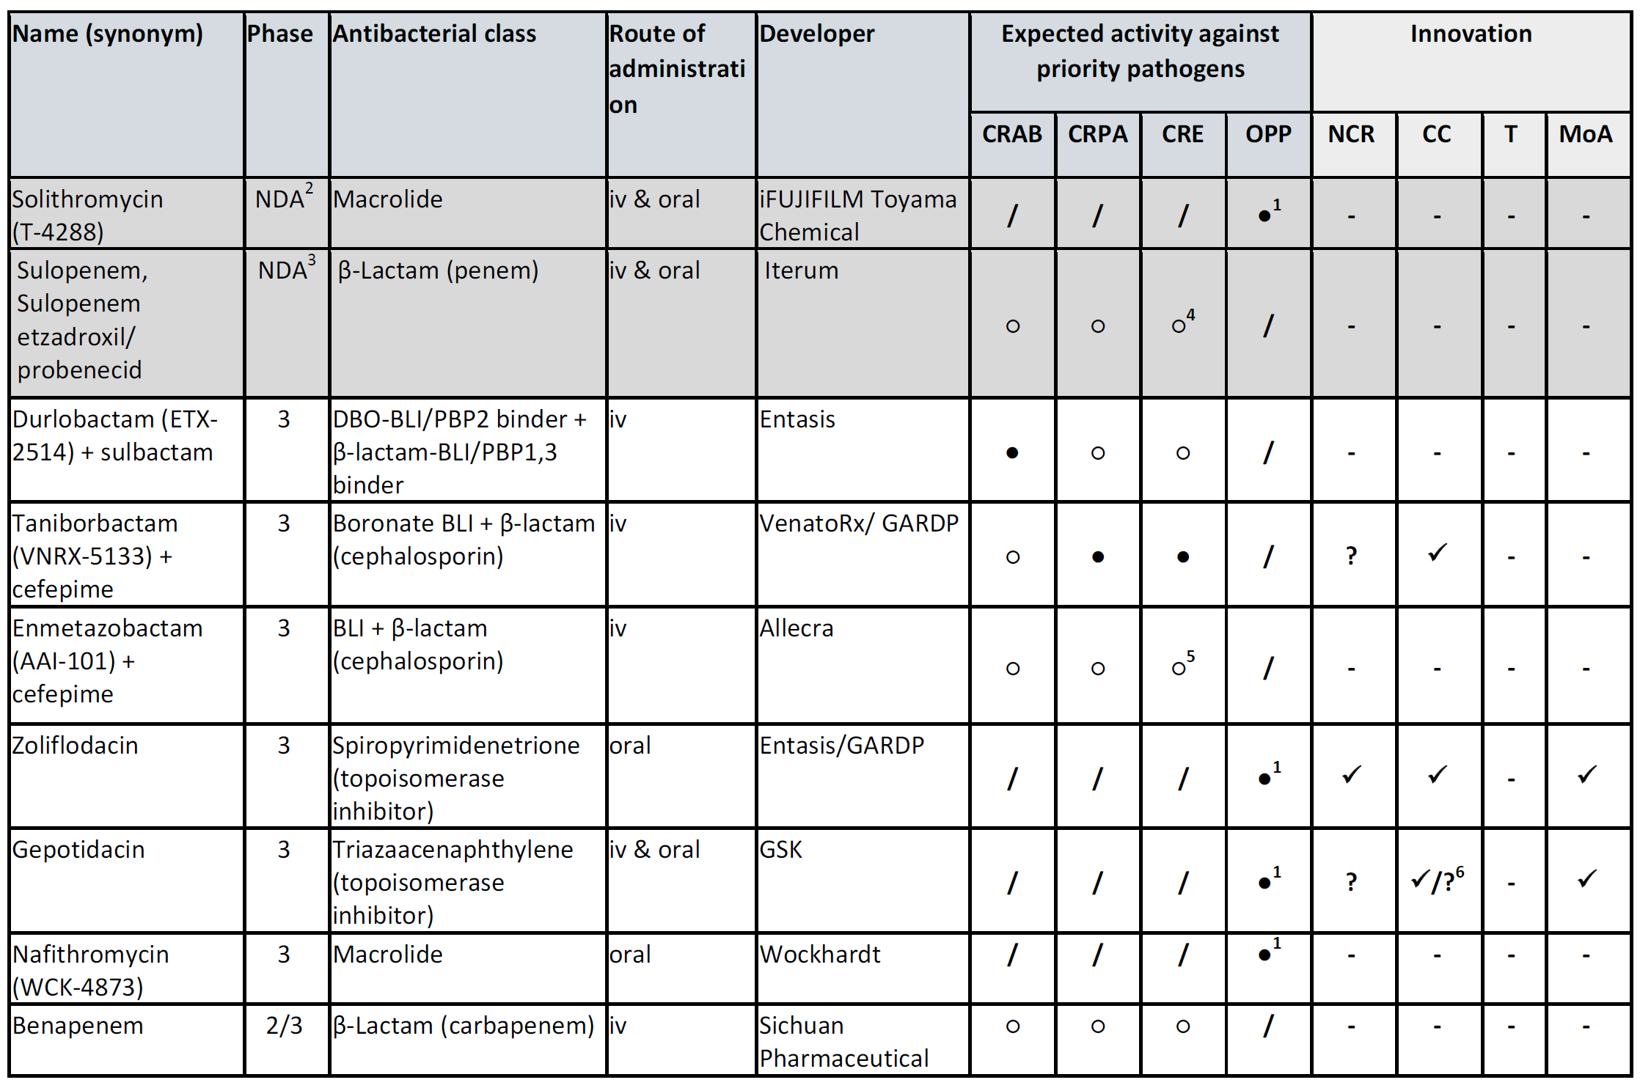
The entire P3 pipeline… fits on one slide
Butler et al. 2022 Antimicrob Ag Chemother (doi:10.1128/AAC.01991-21)

Slide 6
The entire P3 pipeline… isn’t very broad
Acinetobacter baumannii
Butler et al. 2022 Antimicrob Ag Chemother (doi:10.1128/AAC.01991-21)

Slide 7
The entire P3 pipeline… isn’t very broad
Carbepenem-R P. aerug, Enterobacteriaceae
Butler et al. 2022 Antimicrob Ag Chemother (doi:10.1128/AAC.01991-21)

Slide 8
The entire P3 pipeline… isn’t very novel
Novel chemical class
Butler et al. 2022 Antimicrob Ag Chemother (doi:10.1128/AAC.01991-21)

Slide 9
The entire P3 pipeline… isn’t very novel
Novel MoA
Butler et al. 2022 Antimicrob Ag Chemother (doi:10.1128/AAC.01991-21)

Slide 10
At heart, I’m an ID doc who wants new antibacterials and antifungals. My comments come from this experience:
Pre-clinical
Phase 1
Phase 2
Phase 3
Marketed
Micafungin (A)
Fluconazole (A)
Micafungin (A)
Voriconazole (A)
Anidulafungin (A)
Antifungals
Anidulafungin (A)
Caspofungin (A)
Caspofungin (A)
Olorofim (F901318, P)
Ceftaroline-AVI (P)
Meropenem (P)
AA139 (P)
Ceftaroline (P)
Antibacterials
Ceftazidime-avibactam (P)
Ceftazidime-avibactam (P)
Aztreonam-avibactam (P)
Daptomycin (China, P)
Rex JH - Drug Development History, (A)cademia & (P)harma

Slide 11
Scope, Disclosures
This workshop is good start, but there’s more to learn!
Read & listen: See materials on the next slide
Patrice Courvalin’s ICARe course is a great jump-start opportunity
https://www.icarecourse.org/
(blatant plug) Subscribe to the (free!) AMR.Solutions newsletter
Non-traditional approaches are encompassed
They follow the same pathways as any other agent
But they are confusing! See materials on next slide for a deep dive
Finally, and for avoidance of doubt, note that I work at a company that has novel antifungal in development (F901318, olorofim)
I won’t be discussing it at all today
But, I will note that new antifungals are needed and their development follows the same principles as antibacterial R&D!

Slide 12
Read, Listen, & Learn
FDA guidances
https://www.fda.gov/regulatory-information/search-fda-guidance-documents
Set filters to Organization = “Center for Drug Research and Evaluation” and Topic = “Clinical Antimicrobial
In particular, be sure to review the Unmet Need and LPAD guidances. See also the newsletter cited below for the EMA guidances.
FDA Advisory Committees: Attend or listen by webcast to every AdComm. These are free master classes. I can’t emphasize this one strongly enough.
EMA guidances
These have been re-arranged/updated … please see this 27 May 2022 newsletter for a tour: https://amr.solutions/2022/05/27/antibacterial-guidance-including-pediatrics-parallel-emafda-updates/
Papers
Rex, Talbot et al. Progress in the fight against multidrug-resistant bacteria 2005-2016: Modern non-inferiority trial designs enable antibiotic development in advance of epidemic bacterial resistance. CID. 2017;65:141-6.
Boucher, Ambrose, et al. White Paper: Developing Antimicrobial Drugs for Resistant Pathogens, Narrow-spectrum Indications, and Unmet Needs. JID. 2017;216:228-36.
Hope, Drusano, & Rex. Pharmacodynamics for antifungal drug development: an approach for acceleration, risk minimization and demonstration of causality. JAC 2016;71(11):3008-19.
Rex JH, Fernandez Lynch H, Cohen IG, Darrow JJ, Outterson K. Designing development programs for non-traditional antibacterial agents. Nature Communications. 2019;10(1):3416.
Prior meetings
8 Sep 2016: FDA workshop: “Facilitating Antibacterial Drug Development for Patients with Unmet Need and Developing Antibacterial Drugs that Target a Single Species” https://www.fda.gov/drugs/news-events-human-drugs/facilitating-antibacterial-drug-development-patients-unmet-need-and-developing-antibacterial-drugs . Note here the discussion of Drug X-1, a narrow-spectrum agent for P. aeruginosa
2017 GARDP + CARB-X Bootcamp on CMC: https://amr.solutions/2017/09/06/summary-slides-video-from-the-carb-x-gardp-bootcamps-5-8-sep-2017-asm-escmid-conference/
14 May 2018: Duke-Margolis workshop on Non-Traditional Antibiotics: https://amr.solutions/2018/05/14/14-june-duke-margolis-workshop-a-taxonomy-for-non-traditional-non-fleming-antimicrobials/
21-22 Aug 2018: FDA workshop: “Non-Traditional Therapies for Bacterial Infections” https://amr.solutions/2018/08/23/fda-workshop-on-non-traditional-antibacterials-21-22-aug-2018/ . See discussion of Z-3, a hypothetical compound for prevention of acquisition of resistance.
29 Mar 2019: AAC Podcast on “Developing Non-Traditional Antibiotics”: https://www.youtube.com/watch?v=9YKb_RWx1MA

Slide 13
Executive Summary (& Agenda)
We really need new antibiotics! Glad you are here!
Attend to the plumbing: Avoid leaks in the pipe(line)
Manufacturing, PK, ADME, PK-PD, Toxicology, Clinical, Regulatory
Anticipate Phase 3: Is your product developable?
If you build it, will they come? Embed durable value
Summary

Slide 14
Biology: The role of Academia
Drakeman 2014¹: Origins of priority review NMEs, 1998-2012
Sector | NBEs | NCEs | Fast track
Biotech | 24 (92%) | 65 (48%) | 49 (70%)
Pharma | 2 (8%) | 71 (52%) | 21 (30%
Totals | 26 | 136 | 70
In short, small companies (often launched from academic insights) really power the pharmaceutical industry.
But, the move from Biology to Pharmaceuticals is a big leap!
¹Drakeman DL. Benchmarking biotech and pharmaceutical product development. Nat Biotechnol. 2014;32(7):621-5.
NME = New Molecular Entity; NBE = New Biological Entity; NCE = New Chemical Entity

Slide 15
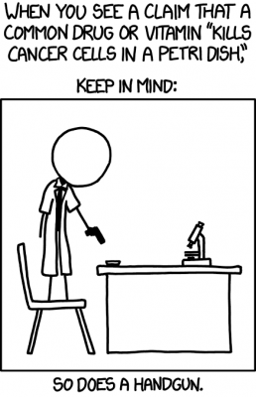
The big question: Is it a drug?
It’s easy to kill bacteria and fungi
Steam, fire, and bleach are very effective
Selective killing is a subtle art
Good checklist: AAC Instructions to Authors
https://journals.asm.org/journal/aac/scope
This 3-part newsletter series on halicin
https://amr.solutions/2020/02/21/chemicals-vs-drugs-the-end-of-bacitracin-the-buzz-around-halicin/
https://amr.solutions/2020/02/24/chemical-vs-drugs-part-2-how-do-you-discriminate-more-on-halicin/
https://amr.solutions/2020/02/25/chemicals-vs-drugs-part-3-xkcd-has-the-final-word/
Let’s take a brief tour of key points
Invisible from the outside, Pharma has a lot of important plumbing!
Image reproduced with permission from https://xkcd.com/1217/.

Slide 16
Can you make it? CMC¹
How does a molecule become a physical medicine (tablet, injectable, etc.) to give to a human?
You must plan for
Early materials for preclinical studies
GMP (Good Manufacturing Practice) materials for human studies
Sufficient quantity at scale & on stability for Ph3 and registration
This is a science unto itself
In parallel with the NDA/MAA (you’ve heard of those), you also file a dossier on the manufacturing process that is of equal length
Advice: Start early! Have a CMC guru on your team
Great CARB-X + GARDP workshop from 2017 on this:
Search for “amr.solutions 2017 bootcamp”
¹Chemistry, Manufacturing, & Controls

Slide 17
What dose? PK, ADME, and PD
PK: Where does it go? What happens to it?
ADME: Absorption, Distribution, Metabolism, and Excretion
Does it go to the right body compartments?
Will it be easy to use? How many doses/day? Is it (can it be) oral?
Does it have (is it likely to have) drug-drug interactions?
You can’t really know the answers in detail until P1, but you can make guesses once you have some PK in some animal species
PD (Pharmacodynamics): What concentration do you need?
Strong PK-PD is the reason a smaller trial program is acceptable proof of drug utility
Deciding on a target exposure is a subtle art. There are talks on this during the workshop; For other ideas see Hope 2016.¹ It’s focused on antifungals, but the ideas do generalize
Hope W, Drusano GL, Rex JH. Pharmacodynamics for antifungal drug development: an approach for acceleration, risk minimization and demonstration of causality. JAC 71:3008-19, 2016

Slide 18
Is it safe? Toxicology (1 of 2)
You need to study supratherapeutic exposures of new agent and its metabolites in 2 animal species
Serious infections often require prolonged therapy: your studies must span relevant periods
0-90 days of exposure: day-for-day coverage in man
180-270 days: enough for indefinite exposure
Metabolites can be tricky. You can try to predict human metabolites but you don’t know until Ph1
Sometimes you have to do additional studies
Forewarned is forearmed. Be sure your investors know!

Slide 19
Is it safe? Toxicology (2 of 2)
Don’t panic! Everything has toxicity
But, take it seriously – toxicity is the main cause of failure in the clinical stages of development
See Prasad AAC 2022 “Leaks in the Pipeline” and this newsletter
https://amr.solutions/2022/06/14/leaky-pipelines-when-is-a-molecule-a-drug/
Your job is to triangulate three things
Exposure that you think is required (PK-PD is your guide)
The nature of the toxicity (monitorable? reversible?)
The Unmet Need you are addressing
This is your first look at benefit-risk (B-R)!
B-R needs be B >>>>>> R for uncomplicated UTI
B-R can (perhaps) be B ≥ R for cure of endocarditis
It depends on the nature of the Risk
Advice: Have a PK-PD expert & a medic on your tox team

Slide 20
How will you develop it?
Get help!
Clinical Operations: Making things happen at sites
Clinical: Medical advice on what’s possible
Regulatory: Rules of the road
It may seem like this things are a long way off…
But, early advice in these disciplines will pay off
FDA & EMA are willing to advise as well

Slide 21
Executive Summary (& Agenda)
We really need new antibiotics! Glad you are here!
Attend to the plumbing: Avoid leaks in the pipe(line)
Anticipate Phase 3: Is your product developable?
Sadly, cool science is not enough!
The SSSS test
Narrow-spectrum and/or rare? Proceed carefully
Indirect effects? Proceed VERY carefully
If you build it, will they come? Embed durable value
Summary

Slide 22
The Bad News
Cool Science ≠ Developable Product
Necessary, but not sufficient
Why? Don’t we need New Drugs for Bad Bugs?
Yes, but it is very hard to study Bad Bugs on their own
Generally easy: Product meets the SSSS test:
Has the spectrum for a defined syndrome and the speed required to be suitable as the sole therapy
Key idea: Most therapy must treat an entire syndrome
Unless the organism is the infection (e.g., TB), it is not always obvious what bacteria is causative
The initial treatment needs to cover all likely causes
Everything else: BIG challenges

Slide 23
STAR: Four treatment archetypes¹
Transform
Restore
Augment
Standalone
Examples
Traditional small molecule
Phage
Antisense
Example
Gram-negative activity from colistin + approved Gram-positive antibiotic
Example
Virulence factor inhibitor or anti-toxin antibody + approved antibiotic
Example
BL-BLI (Beta-lactam beta-lactamase inhibitor) combinations
Rex et al. Designing development programs for non-traditional antibacterial agents. Nature Communications. 2019;10(1):3416.

Slide 24
Standalone, Transform, and Restore: Direct activity
Has the speed and spectrum to be the sole therapy
Examples:
Standalone (NEW on its own):¹ Phage, lysins, antisense, and (of course) standard small molecules
Transform: NEW added to 2nd agent not otherwise active on the target (e.g., polymyxin + known Gram-positive agent where combo has Gram-negative activity)
Restore: BL-BLI
In each case, an entity complete in itself
Even if it has more than one component
Usually has an MIC
Key advantage: Standard NI trials² can be used
This would also describe ANY new mechanism standalone molecule, small or large.
NI = Non-inferiority trials. I just do not have time today to go into trial designs and the deep topic of non-inferiority vs. superiority!! Please see https://amr.solutions/2020/09/19/in-praise-of-non-inferiority/ and its related YouTube video: https://youtu.be/dx9mrQfSNT4

Slide 25
Narrow-spectrum problem (1 of 2)
Narrow-spectrum antibiotics require a setting where activity for a specific pathogen can be seen in isolation. There are 3 possible patterns:
Pattern A: Organism = Syndrome (N. gonorrhoeae)
Other examples: TB, Salmonella, etc. Never normal to carry these!
Diagnostic can select; Straightforward study design
Pattern B: Organism appears within a syndrome and symmetrical gaps in the spectrum of existing agents make it possible to show activity of NEW:
Example: ertapenem¹ does not cover P. aeruginosa. So, NEW + ertapenem vs. imipenem shows activity of NEW.
Low rate of P. aeruginosa is the remaining problem
A diagnostic could support selective enrollment
Ertapenem is a carbapenem that lacks activity against Pseudomonas aeruginosa. Imipenem is a carbapenem that DOES cover P. aeruginosa. So, you could say that ertapenem has a Pseudomonas-sized hole in its spectrum relative to imipenem. See also link to a workshop on Drug X-1 on the “Read, Listen, and Learn” slide, a hypothetical narrow-spectrum agent for P. aeruginosa

Slide 26
Narrow-spectrum problem (2 of 2)
Pattern C: Organism is one of several causes of a syndrome and existing agents often cover it
Ex: Klebsiella as a component of cIAI & pneumonia
Therapy in these conditions is syndromic
There is a strong desire for therapy that covers all likely pathogens
Danger, Danger, Will Robinson!
ALERT: This is a HARD problem ... Be careful!
It will likely be hard to arrange things so that your product can be seen to be active
Perhaps you could do this for E. coli in UTI
A diagnostic is NOT a reliable fix for this … it is very hard to know which bug is doing what
This difficulty surfaces both during development (hard to run a trial) and in routine care (hard to know when to use the selective agent)
And a focus on just MDR K. pneumoniae will not fix it (next slide)…

Slide 27
Narrow (and/or Rare): Summary
Unless the pathogen is distinct to the infection, pursuit of individual pathogens or (just) rare pathogens (MDR or otherwise) is very hard
A rapid diagnostic does not create the patients!
If the target organism has a frequency of 1%, then you must screen 100 to find that 1 … or even more if the diagnostic is imperfect
Net of all this advice: Products that meet the SSSS¹ test are much more easily developed
Everything else is harder
Get help early – make plans to solve this problem!!
¹SSSS: Has the spectrum for a defined syndrome and the speed required to be suitable as the sole therapy.

Slide 28
STAR: Four treatment archetypes¹
Transform
Restore
Augment
Standalone
Examples
Traditional small molecule
Phage
Antisense
Example
Gram-negative activity from colistin + approved Gram-positive antibiotic
Example
Virulence factor inhibitor or anti-toxin antibody + approved antibiotic
Example
BL-BLI (Beta-lactam beta-lactamase inhibitor) combinations
Rex et al. Designing development programs for non-traditional antibacterial agents. Nature Communications. 2019;10(1):3416.

Slide 29
Augment an existing therapy
Example: Virulence inhibitor or such
Usually lacks an MIC equivalent and has no discernible in vitro effect on the base therapy in the laboratory
Not sufficient alone: Must also give an active antibacterial (e.g., toxin inhibitor + an SSSS antibiotic)
Distinctive hurdles
Base therapy needs to work
Might protect a base therapy from emergence of resistance but doesn’t solve existing resistance problems
Dose: Lack of an MIC → harder to apply PK-PD
If the PK-PD rationale has gaps, it becomes harder to validate dose/exposure logic. You may need two studies
Superiority problem: Must show NEW + SOC¹ > SOC
This needs a slide of its own…
SOC = Standard of Care

Slide 30
Superiority¹ & Endpoints
Ultimately, these agents force a study of this form
NEW + SOC vs. SOC … and with fully dosed, active SOC
We will want to see that NEW + SOC is superior to SOC
Are there settings where this might be possible?
Endocarditis is a good candidate: more rapid bloodstream clearance might have a measurable clinical effect
But, this is a hard study to enroll and there is so much noise in the data – clinical improvement may be tough
Endpoints: Would different endpoints help?
A challenging question! Whatever is proposed must be compelling.
Are there population-level variations on “feels, functions, survives” that we should begin to recognize? No good answers here, as yet.²
Finally, know that this is not a regulatory problem per se
The agencies are simply the first to point out the issue
Why should I use this? Why should I pay for this?
For more on this, see https://amr.solutions/2020/09/19/in-praise-of-non-inferiority/ and its video: https://youtu.be/dx9mrQfSNT4
See link to a workshop on Drug Z-3 on the “Read, Listen, and Learn” slide, a hypothetical agent for prevention of acquisition of resistance.

Slide 31
Executive Summary (& Agenda)
We really need new antibiotics! Glad you are here!
Attend to the plumbing: Avoid leaks in the pipe(line)
Anticipate Phase 3: Is your product developable?
If you build it, will they come? Embed durable value
Reimbursement is changing – you should plan for this!
Summary

Slide 32
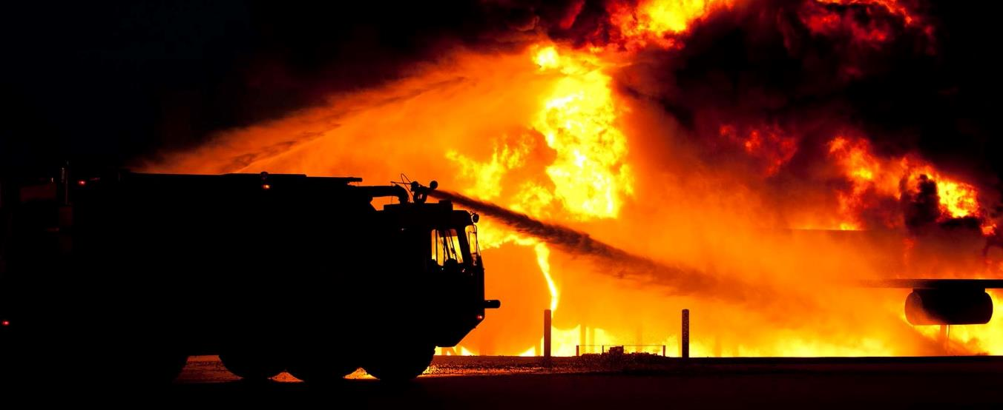
Pop Quiz: Have you used a fire extinguisher today?

Slide 33
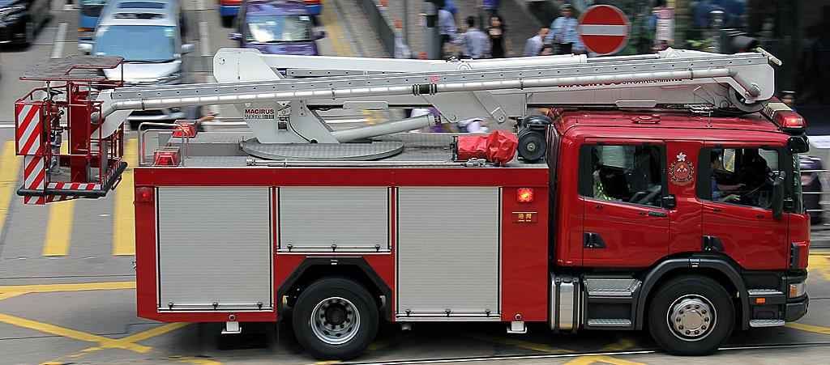
Pop Quiz: Have you used a fire extinguisher today?
Let’s be more concrete.
Are you using a fire extinguisher right now?

Slide 34
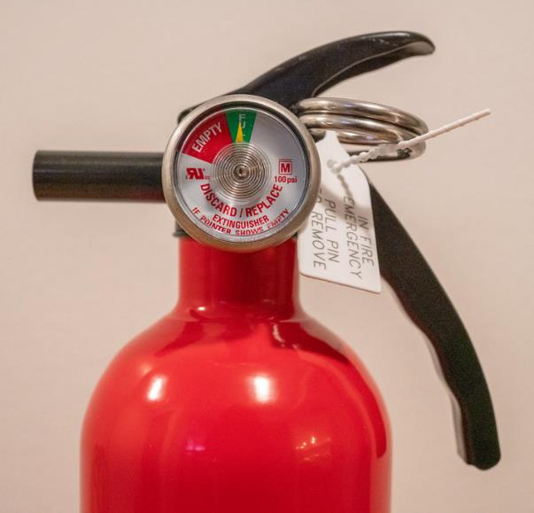
Fundamental starting point
Antibiotics enable all of modern civilization!
Safety net for surgery, cancer therapy, and essentially everything else
Infrastructure for civilization: Healthy citizens make the economy go!
Stated differently…
Antibiotics are the fire extinguishers of medicine!
Speaker personal opinion.

Slide 35
Current economic model is broken
Current approach to antibiotics
Everyone is delighted to have a new antibiotic
But, use is delayed and deferred in effort to preserve new antibiotic
Stewardship perspective: Entirely rational
Economic perspective: A financial loss
Many analyses show same thing
It is not financially rational to do antibiotic R&D
Bankruptcies! Achaogen, Melinta
http://amr.solutions/blog/scary-scarier-scariest-achaogen-ft-editorial-cbs-60-minutes-on-amr
https://amr.solutions/2020/01/05/melinta-goes-bankrupt-never-let-a-good-crisis-go-to-waste/
Issue: Pay-per-use model reimburses for only a piece of the value … & we’re working to fix this…

Slide 36
STEDI: Antibiotic value beyond mere use But, we don’t (yet) have an agreed way to capture these values
Antibiotics are the fire extinguishers of medicine!
Table from Outterson K, Rex JH. Evaluating for-profit public benefit corporations as an additional structure for antibiotic development and commercialization. Translational Research, 2020. The STEDI concept was adapted from Rothery et al. Framework for Value Assessment of New Antimicrobials. http://www.eepru.org.uk/wp-content/uploads/2017/11/eepru-report-amr-oct-2018-059.pdf, 2018.

Slide 37
It’s expensive!
Average all-in cost to approval¹ = $1.3b
Running costs of a drug in its first 10 years: $350m²
$100m in post-approval commitments: pediatrics, etc.
$25m/year to run the plant that makes your drug, surveillance, pharmacovigilance
All together: ~$1.7b per molecule
Usage-based income will not recover those costs^{3,4}
New antibiotics often have ≤ $25m/year in sales
Can it be done for substantially less?^{5,6}
On average, no. There are no discounts or regulatory shortcuts for being small or large, for-profit or non-profit, degree of novelty, etc.
Small company models are already very, very lean⁵
¹Wouters J, et al. JAMA 2020;323:844–53. AMR.Solutions: “Melinta, Part 2 / Bankruptcy Is Not The End / Post-Approval Costs For An Antibiotic”, available at https://amr.solutions/2020/01/07/melinta-part-2-bankruptcy-is-not-the-end-post-approval-costs-for-an-antibiotic/. ³AMR.Solutions: “Mandatory Reading: Alan Carr’s Jan 2020 Antibacterial And Antifungal Market Review”, available at: https://amr.solutions/2020/01/28/mandatory-reading-alan-carrs-jan-2020-antibacterial-and-antifungal-market-review/. ⁴AMR.Solutions: “What Does An Antibiotic Cost To Develop? What Is It Worth? How To Afford It?”, available at: https://amr.solutions/2020/03/06/what-does-an-antibiotic-cost-to-develop-what-is-it-worth-how-to-afford-it/. ⁵Drakeman DL. Benchmarking biotech and pharmaceutical product development. Nat Biotechnol, 32(7): 621-5, 2014. ⁶AMR.Solutions: “All-In Cost Of A New Antibiotic From Discovery To 10 Years On Market”, available at https://amr.solutions/2021/01/09/all-in-cost-of-a-new-antibiotic-from-discovery-to-10-years-on-market/

Slide 38
Paying for it: Push and Pull
Substantial public thinking over the past 10+ years
UK AMR Review; DRIVE-AB project; US legislative efforts; Swedish pilot project, EU Pharma strategy, and more
Key insights: We need 2 different kinds of funding
Push incentives that encourage work to start: Grants
$750m for Discovery to Phase 1: CARB-X, Novo REPAIR, etc.
$1b for Phase 2-3: AMR Action Fund
Lots of (mostly small) companies have entered the fray
Pull incentives paid on successful approval
Many papers on this, see amr.solutions for more
In particular, the 1 Sep 2020 newsletter is a good start
https://amr.solutions/2020/09/01/reimbursing-for-innovative-antibiotics-encouraging-updates-from-the-amr-conference/
Video explainer: https://www.youtube.com/watch?v=6gd8iXLbZak

Slide 39
How does Pull work?
Pull = Payments made without regard for use¹
The UK pilot as a benchmark: The UK has identified two high-end new agents for Gram-negative bacterial infections
The UK is contracting to buy them for the UK at up to GBP 10m/yr
Scaled to 10 years and to full 10m/yr, this is GBP 100m
The purchase is independent of actual use
The UK is 3% of the G20: 100m x 33 = GBP 3.3b ≈ $4b
This is right on target! Strong work, Team UK!
All estimates² converge on $2-4b as the needed reward size
This type of Pull incentive levels the economic playing field!
So, how do we engage and extend?
Wealthy countries need to contribute their fair share
Targets must be fair and consistently available
So far, the only sizeable further effort is in the US (PASTEUR)
See https://amr.solutions/2021/09/14/outstanding-discussions-of-pull-the-nhs-pilot-and-antibiotic-value/. See also this excellent 5-minute video explainer: https://www.ft.com/video/adada10f-5747-4976-a3e0-958b0165e0ef
Multiple estimates have been made. The best current summary is found in Outterson K, Estimating The Appropriate Size Of Global Pull Incentives For Antibacterial Medicines. Health Affairs. 2021;40(11):1758-65. Also see a recent report to the G7 Finance ministers discussed in this newsletter: https://amr.solutions/2022/06/04/notable-reports-incentives-who-amr-hub-strategy-barda-capacity-building-fleming-fund/

Slide 40
Pull awards can/will guide R&D
Think of R&D as a big ship … a 10- to 15-year-long ship
Big ships turn slowly, but they do turn
Pull awards tied to desired features will turn the ship
Novelty, Indications, and Spectrum can all be measured¹
The UK Pilot has published a point scoring system²
Key: Targets must be held constant
Products coming to approval at any given time are the result of decisions made a decade or more previously
Some additional detail on next slide. For an extended discussion…
AMR.Solutions:³ “Assessing Antibiotic Value: DTR, Fire Extinguishers, And A View From Australia” -- the idea of Difficult-to-Treat-Resistance (DTR) is a noteworthy build on features such as novelty and spectrum
Hint, hint: What does this tell you about choosing a project?
Big Pull rewards will only go to projects that make you say “Wow! I need that!”
Example on next slide
¹Rex JH, Outterson K. Antibiotic Reimbursement in a Sales-Delinked Model: Context and a Benchmark-Based Global Approach. The Lancet Infectious Disease, 16: 500-5, 2016. ²Search for “slide 25” on https://amr.solutions/2020/03/29/uk-antibiotic-subscription-pilot-implies-pull-incentive-of-up-to-4b-across-the-g20/. ³https://amr.solutions/2020/06/07/assessing-antibiotic-value-dtr-fire-extinguishers-and-a-view-from-australia/

Slide 41
UK Pilot: Point Score Scheme
Up to 11,250 points for priority pathogen coverage
Unmet need: Up to 6000 points across High, Medium, and Low unmet need
Coverage of key resistance determinants: Up to 6000 points based on extent of coverage of pathogens expressing various resistance determinants.
Utility in various disease settings: Up to 6000 points for the spectrum of primary care (lowest) to ICU (highest)
Novelty: New class (2000 points), New target (1500 points), New Mechanism of Action (1500 points), low rate of development of resistance (1500 points), lack of cross-resistance (1000 points), and Other benefits (up to 500 points)
Certainty of supply, Stewardship, and arrangements for Surveillance are each worth up to 5000 points
The PASTEUR Act in the US is likely to have a similar feel!

Slide 42
Executive Summary (& Agenda)
We really need new antibiotics! Glad you are here!
Attend to the plumbing: Avoid leaks in the pipe(line)
Anticipate Phase 3: Is your product developable?
If you build it, will they come? Embed durable value
Summary

Slide 43
Key points
Get help with the parts where you are not expert
CMC, toxicology, PK, PK-PD, Clinical, Regulatory … these are very special domains.
This workshop will introduce you to sources of help!
Plan for Phase 3
How will you study it? In whom will you study it?
Is that study feasible in non-geologic time?
Will anyone care?
What is the “Wow, I need that!” story for your drug?
Places to start? Novelty, oral, lack of cross-resistance

Slide 44
Strategies for Early R&D: Plumbing, Phase 3, and Durable Value
Thanks for listening!
John H. Rex, MD
Chief Medical Officer, F2G Ltd Editor-in-Chief, AMR.Solutions Operating Partner, Advent Life Sciences Adjunct Professor of Medicine, McGovern Medical School
22 June 2022
NIAID - Early R&D Strategies for Novel Antibacterial and Antifungal Drugs
Email: john.h.rex@gmail.com
Newsletter: http://amr.solutions
Slides happily shared … just drop me a note
Please note these details!

