Slide 1
The Post-Approval Challenges of Antimicrobial Development
Committee on the Long-Term Medical and Economic Effects of Antimicrobial Resistance
National Academy of Science, Medicine and Engineering
January 5, 2021

Slide 2
Disclosures and Disclaimer
Kevin Krause is the V.P. Clinical Sciences and Development Operations, and a shareholder in AN2 Therapeutics, Inc.
He is a former employee of Achaogen, Cerexa (Forest Laboratories/Actavis, Allergan, now Abbvie) and Theravance
He played various roles in the clinical development, approval and/or launch of Zemdri® (plazomicin), Avycaz® (ceftazidime-avibactam), Teflaro® (ceftaroline fosamil), Vibativ® (telavancin), Colobreathe® (inhaled colistin) and Quinsair® (inhaled levofloxacin)
He has accepted consulting fees from Achaogen, Inc., Cipla USA, Spero Therapeutics, Felix Biotechnology, ID Biologics, Genentech/Roche, SMAC, and F-prime Capital
He is an advisor to and shareholder in BioAmp Diagnostics
The views and opinions expressed in this presentation are those of the author

Slide 3
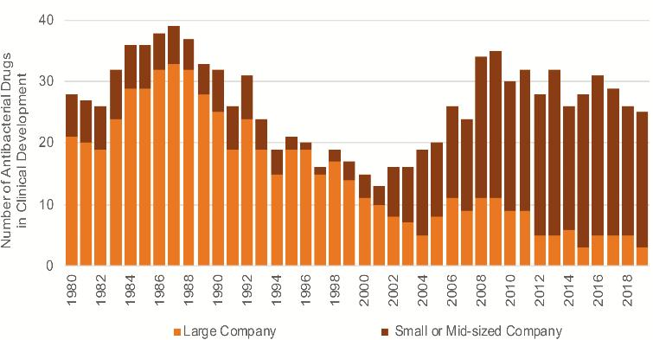
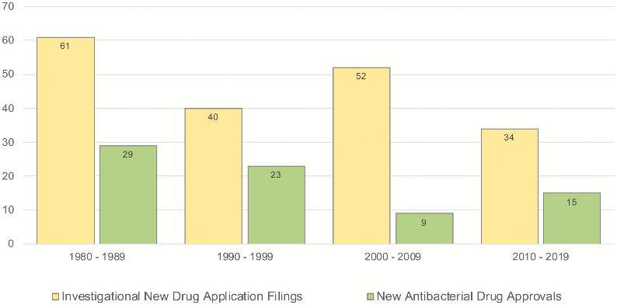
Antibiotics - It’s Not About the Size of Profit but Rather the Magnitude of the Loss
The market does not support investment in new drugs
Revenue is significantly less than R&D and post-launch costs
7+ years before an antibiotic makes enough money to pay annual costs of keeping it on the market
It takes 23 years (O’Neill AMR report) for an antibiotic to break even…just as the patent is expiring
The shrinking pipeline mostly sits with small companies that can’t absorb post-launch losses, increasing the risk that new drugs don’t survive
Clin Infect Dis, ciaa859, https://doi.org/10.1093/cid/ciaa859

Slide 4
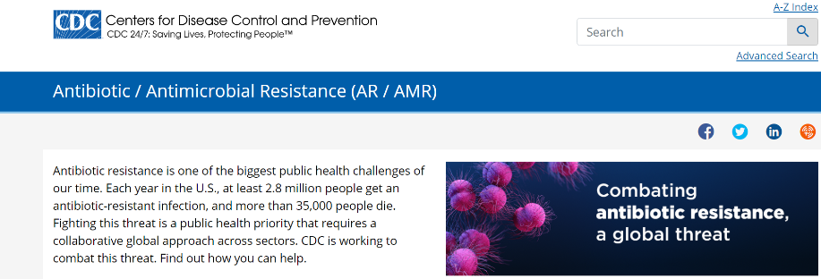
Why is the Marketplace so Challenging?
We have a basic math problem:
There aren’t a lot of patients and new drugs are reserved
New drugs cost a lot of money to keep on the market
The market does not accept the high prices needed to keep a rarely used drug on the market
How drugs are developed vs. how they are used are different
Package insert and/or publications not always informative for formulary or treatment decisions
Treatment guidelines often recommend only off-label use, which the company can’t promote
AMR is a large problem, but individual resistance types are a rare disease
No antibiotic is designed to address “2.8 million people [that] get an antibiotic-resistant infection”

Slide 5
Focus of Today’s Talk
Required post-approval expenses are substantial - why?
Post-marketing regulatory commitments
Manufacturing expense and availability in the U.S.
AST development costs (see tomorrow’s agenda)
Global Drug Safety/Pharmacovigilance infrastructure and reporting, Medical Affairs, Sales and Marketing
Resources:
Bootcamp: Post-Approval Economics for New Antibiotics (ASM/ESCMID 2019) – REVIVE (gardp.org)
Post-approval revenue is typically low - why?
True unmet need patients are uncommon to rare, but consequences are high
~70% mortality reported for invasive Gram-negative infections when effective therapy unavailable
Formulary review, out of date breakpoints, stewardship, clinical data availability, etc.
Pricing and reimbursement challenges for the hospital
Resources:
Why are new antibacterials failing as commercial products? – by Patricia A. Bradford – REVIVE (gardp.org)
Why is it so hard to develop new antibiotics? | Wellcome
New Antibiotics Development | Newsletter by John Rex | AMR Solutions
Home | AMR Review (amr-review.org)

Slide 6
Expected 5-Year Expenses For A New Antibiotic Are Daunting Not Shown: Sales, Marketing, Company Operations, and Employee Costs
Commitment | Single Indication, Minimum requirements | Two Indications Some safety signals | Several indications Expected broad use
Pediatric PK and Safety Studies | $25M | $50M | $75M
Additional Phase 3 study | N/A | $50M | $75M
PK in Special Adult Populations | $2M | $3M | $5M
Surveillance | $3M | $5M | $5M
Pharmacovigilance | $5M | $5M | $5M
Medical Affairs | $50M | $50M | $50M
AST | $7M | $7M | $7M
Drug Manufacturing | $150M | $250M | $400M
Total | $242M | $420M | $622M
From: Bootcamp: Post-Approval Economics for New Antibiotics (ASM/ESCMID 2019) – REVIVE (gardp.org)

Slide 7
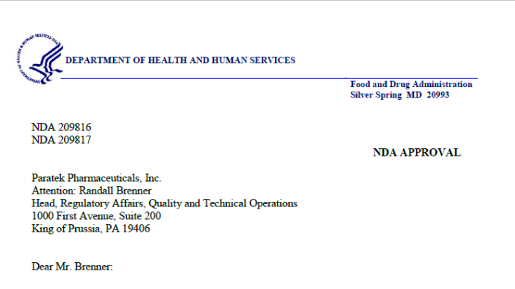
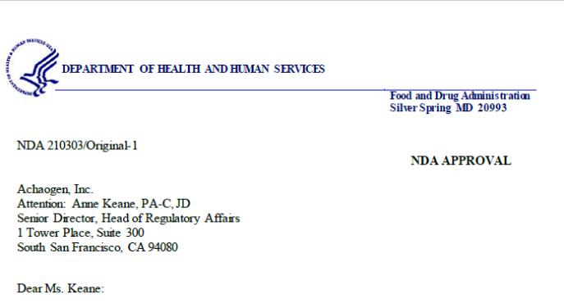
Clinical Expenses - Meeting Requirements for an Approved Product
Post-marketing commitments/requirements
NDA approval letter describe PMRs/PMCs; publicly available
Pediatric study(s)
Additional safety/PK studies
Sometimes P3 “do overs” (!!!)
Microbiological surveillance
Pharmacovigilance
Systems and staff to provide support and record/track/resolve any product concerns
Quarterly and annual reports to FDA; Drug safety update reports; Surveillance reports
Medical Affairs
Medical information receives and responds to queries from HCPs
Can discuss “off-label” data to help HCPs understand data published but not in Package Insert
Susceptibility testing devices (AST)
Required for labs to determine antibiotic susceptibility
Notes:
Zemdri:
PK and safety in cUTI Peds patients
PK and safety in ESRD
Surveillance
Omadacycline:
PEDS study in pts 8-18 (waived 0-8 bc of safety): PK in pts; active-control safety study in ABSSTI; active-control safety study in CABP;
Conduct a CABP study in adults
Surveillance

Slide 8
Manufacturing/Tech Ops Expenses Key Decisions To Supply The Market Are Made At Risk
Lowest Cost
Balanced
No Risk of Stockouts
Sweet Spot
Single Source
Mix Single & Dual
Multiple Sources
Capacity
Inventory Policy
Low
Medium
High
Distant
Engaged
Directive
Oversight
TOTAL COST
(over 5 years)
~$150M
~$250M
~$400M
From: Bootcamp: Post-Approval Economics for New Antibiotics (ASM/ESCMID 2019) – REVIVE (gardp.org)

Slide 9
Potential Supply Chain Map Few Manufacturers, Multiple Continents & Long Lead Times
Source (Lead Time: 8 mo)
Make (Lead Time: 14 mo)
Deliver and Return
Source(s)
Source(s)
IHP
Raw Material
Drug Substance (DS)
3PL (FG)
Raw Material
IHP
TBD Warehouse (DS)
Channel Distribution
Raw Material
DS: Drug Substance
DP: Drug Product
FG: Finished Goods
3PL: Third Party Logistics
IHP: Inventory Holding Point
Raw Material
Drug Product (DP)
Pack & Label (FG)
~24 Months
From: Bootcamp: Post-Approval Economics for New Antibiotics (ASM/ESCMID 2019) – REVIVE (gardp.org)

Slide 10
Drug Batches Takes Several Years To Complete Manufacturing Expenses Incurred Years Before Product is Sold
From: Bootcamp: Post-Approval Economics for New Antibiotics (ASM/ESCMID 2019) – REVIVE (gardp.org)

Slide 11
New Drugs Are Focused On Individual Resistance Types, Not AMR Example - The CRE U.S. Market is <0.5% of AMR Patients
Downloaded from: galflwebcwnd000013.jpg (1280×720) (sec.gov)
CDC reports 13,100 CRE patients in the U.S. per year, but where are they?
Need geographically dispersed (expensive) field teams to make sure drug gets to these patients
Need to charge $50,000/treatment course for a drug that treats 2,500 patients per year to cover annual expenses of $100m in a no-profit scenario

Slide 12
Illustrative Example - >$420M cumulative shortfall vs. $20M raise These are real numbers averaged across many products!
Self-sustaining revenue in Year 7
Does not mean break-even point!
$500M - $1B invested before launch not accounted for in this math
These costs apply to companies of any size – requirements aren’t reduced for a smaller company with fewer resources
Net Revenue = Sales – Clinical, Manufacturing, and Sales/Marketing Expenses
Profitability = Net Revenue – Company Operations (leases, salaries, finance, HR, etc.) of $40M/year
From: Bootcamp: Post-Approval Economics for New Antibiotics (ASM/ESCMID 2019) – REVIVE (gardp.org)
-$420M

Slide 13
Can’t Commercial Companies Always Raise Money?
Raising Money is challenging in the face of a declining stock price
Small company equity raises limited to ~20% of the market cap
Illustrative Example:
We are still $383M short!
10* antibiotic pure-play companies totaling $1.76b in market cap
(as of 12/31/20 close)
$176M average; Range $7.7-$527.3M
20% dilutive raise nets average $35.2M, $1.5 - $105M at range limits
*Cidara, Contrafect, Entasis, Iterum, Nabriva, Paratek, Scynexis, Summitt, Spero, Synthetic Biologics

Slide 14
Plus…Antibiotic Companies Stock Price Often Drops After Approval
Positive clinical data drives up stock value pre-NDA
Seen as an inflection point and traditionally where M&A occurs
Increased stock value and looming commercial investments trigger early investors to take profits
Broader investor base can mean more volatility
At the same time, the company risk profile changes and increases
Will the drug be approved?
What will the final package insert say?
Will the launch meet expectations?
M&A doesn’t materialize in the face of market challenges
Any new institutional investor will want proof of commercial success
Leads to the “Short the Launch” scenario
Single product companies lose 40% of market cap on average and see increase in short position at launch
From: Bootcamp: Post-Approval Economics for New Antibiotics (ASM/ESCMID 2019) – REVIVE (gardp.org)

Slide 15
Can’t Commercial Companies Always Raise Money, Part 2?
Investors know three things:
Launching a drug is incredibly expensive
Launches often underperform in the hospital and in the antibiotic space
Money invested at launch is likely to be further diluted later (i.e. first money in does not win)
Companies may turn to debt, but it will be “expensive” at this point
High interest rates
Challenging covenants based on sales milestones
Increasing financial strain decreases investor confidence
Short interest begins to increase, putting further price on the stock
Investors understand these financing challenges and will wait on the sidelines, making raising money that much tougher

Slide 16
Conclusions
The cost to develop and maintain a branded antibiotic greatly outweigh the sales potential
Economists would call working in the space an “irrational investment”
Push incentives have saved the R&D pipeline for new drugs
However, companies are largely in the negative once the product launches
Few to no financial options to maintain antibiotics on the market
Lack of exit options
Pull incentives are needed to keep these drugs on the market in even in the best-case scenario (is this enough?)
DISARM Act – reimburse antibiotics outside of the bundled payment system – removes artificial cap/financial COI; should tolerate higher pricing
PASTEUR Act – award a bulk payment/subscription; removes pressure to push high volume
…or we need to accept disease/orphan like prices, otherwise we will no longer have new antibiotics

